Slide 1
Balance of Payment

Slide 2
Balance of Payment
A balance of payment (BoP) is a summary statement that lists all of the transactions that took place within a specific period between the resident and the outside world.
It indicates the extent to which a country saves enough money to cover its imports.
It also reveals whether the country produces adequate economic output to fund its expansion.
Usually, BoP is in equilibrium, which means that all the debit items are equal to the credit items.
In equilibrium, the total of current and capital accounts is equal to 0, as they balance each other out.

Slide 3
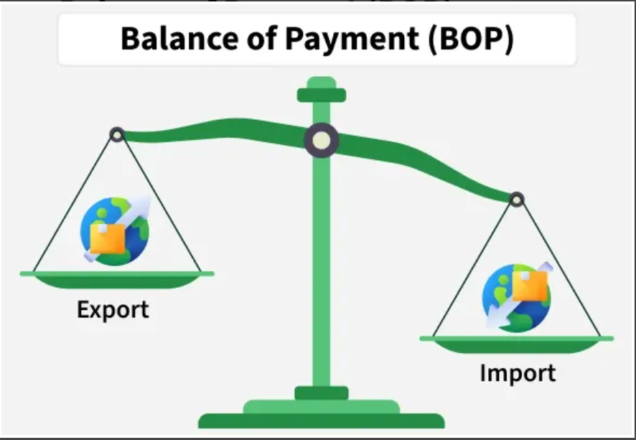

Slide 4
Equilibrium Condition
Capital Account + Current Account = 0
But sometimes there are cases when it is not balanced. This means that either credit items > debit items or debit items > credit items. It is called disequilibrium in BoP. It can either be in the form of a surplus or deficit. In that case, the capital and current accounts can not balance each other out. If the total of the current and capital accounts is a positive number i.e., greater than 0, then it indicates a BoP Surplus. If the total of the current and capital accounts is a negative number, i.e., smaller than 0, then it indicates a BoP Deficit.

Slide 5
Balance of Payment vs Balance of Trade
Balance of Trade refers only to the difference between the value of a country’s exports and imports of goods. It shows whether the country is earning more from selling goods abroad or spending more on purchasing goods from other countries. Balance of Payments is a broader concept because it includes not just goods, but also services, unilateral transfers, capital flows, foreign investments, and changes in foreign exchange reserves. Therefore, BoT gives a partial view while BoP gives a complete picture of all international transactions.

Slide 6
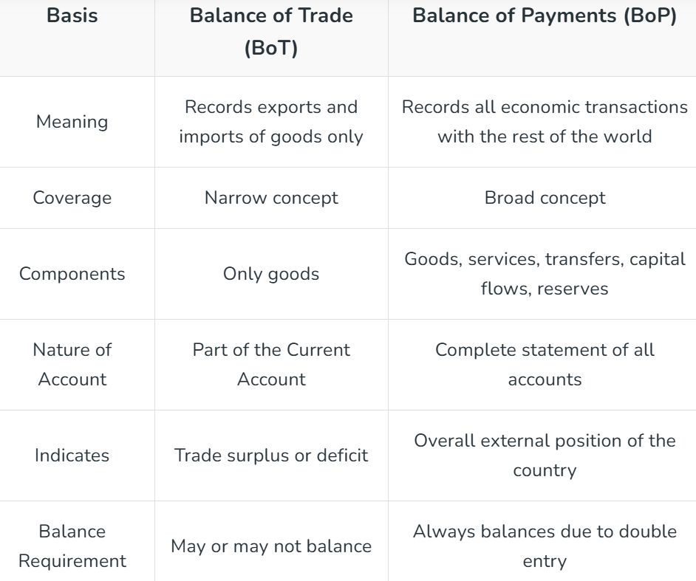

Slide 7
Components of Balance of Payments
The Balance of Payments is divided into two major accounts: the Current Account and the Capital Account. Each account records a different type of international transaction between the country and the rest of the world.
Current Account
The Current Account records the import and export of goods and services and includes unilateral transfers. It consists of:
Export and import of goods • Export and import of services • Income receipts and payments like interest, wages, and dividends • Unilateral transfers such as gifts, remittances, and donations
A surplus in the Current Account means foreign exchange earnings are higher than payments. A deficit means the country is spending more foreign exchange than it is earning.

Slide 8
Capital Account
The Capital Account records capital transfers and transactions involving the buying and selling of non-produced and non-financial assets. It includes:
• Capital transfers such as grants for capital purposes
• Acquisition or disposal of assets like land, buildings, patents, copyrights, and trademarks
• Debt forgiveness
This account shows one-time capital movements and helps track changes in ownership of assets between countries.

Slide 9
Balance of Payments: Surplus and Deficit
In reality, international payments are similar to that of individuals who spend more than they earn and finance the gap by borrowing money or selling assets. A country can sell assets or borrow money from overseas to cover a gap in its current account (spending more than it brings in from sales to the outside world). Therefore, any current account shortfall must be covered by a capital account surplus or net inflow of capital into the country.

Slide 10
Balance of Payments: Surplus
It is a favourable situation when the country's export is more than its import. The country can create more capital to pay for its domestic productions. An increase in the level of production will ultimately help in the short-term growth of a country. Under this:
Payment made by the country is certainly less than the receipts received by the country.
This means that a country's foreign currency inflows exceed its outflows within a specific period.
In simple words, Credit Side > Debit Side

Slide 11

Balance is in surplus when:

Slide 12
Balance of Payments: Deficit
It is an unfavourable situation when the country's import is more than its export of goods and services. It means that a country is spending money more than it earns. In this case, it has to borrow to pay for its imports. Thus, it creates a problem for the economy. Under this:
Payment made by the country is certainly more than the receipts received by the country.
This means that a country's foreign currency outflows exceed its inflows within a specific period.
In simple words, Credit Side < Debit Side

Slide 13
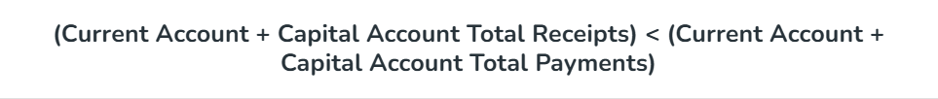
Balance is in deficit when:

Slide 14
In the case of BoP Deficit, it must be noted that:
The official reserves can be used to amend the BoP deficit. But, the decision regarding this lies with the Reserve Bank of India. This is because RBI acts as a custodian of foreign reserves and all foreign transactions are managed by the RBI. The official reserves mean the overall balance of the Balance of Payment account. ( Overall balance is the total of the Current account, Capital account, and Errors and Omissions).
The decrease in the official reserves account signifies the BoP deficit (for this reason the overall balance is negative).
The Reserve Bank of India (RBI) has the authority to manage the currency and money supply. This authority is known as the Monetary Authority. This final decision to finance the deficit that arises in the country's BoP lies with the RBI.
The official reserves can only be used to settle the deficit when there are pegged exchange rates (fixed). In floating exchange rates, it can not be considered.
When the Balance of Payment is balanced, it is said to be in equilibrium. But when the country is either in surplus or deficit, then it is said to be in disequilibrium. Disequilibrium is a major concern for the government, thus it is necessary to understand its cause and effects on the country.

